Slide 1
WikiHow
Text Summarization
Team 4
Prashanth Aripirala
Rohit Macherla
Vishal Reddy Mekala
Cohort 2 Presentation - Done!

Slide 2
Introduction
The project aims to utilize pre-trained Large Language Models (LLMs) for text summarization through diverse fine-tuning techniques.
Large Language Models used:
T5-small
BART-base
Fine-tuning techniques used:
Simple Fine-tuning
LoRA Fine-tuning
Comparative analysis with baseline LSTM/Transformer models are undertaken, utilizing established metrics such as rouge score and BLEU.
Notes:
Vishal

Slide 3
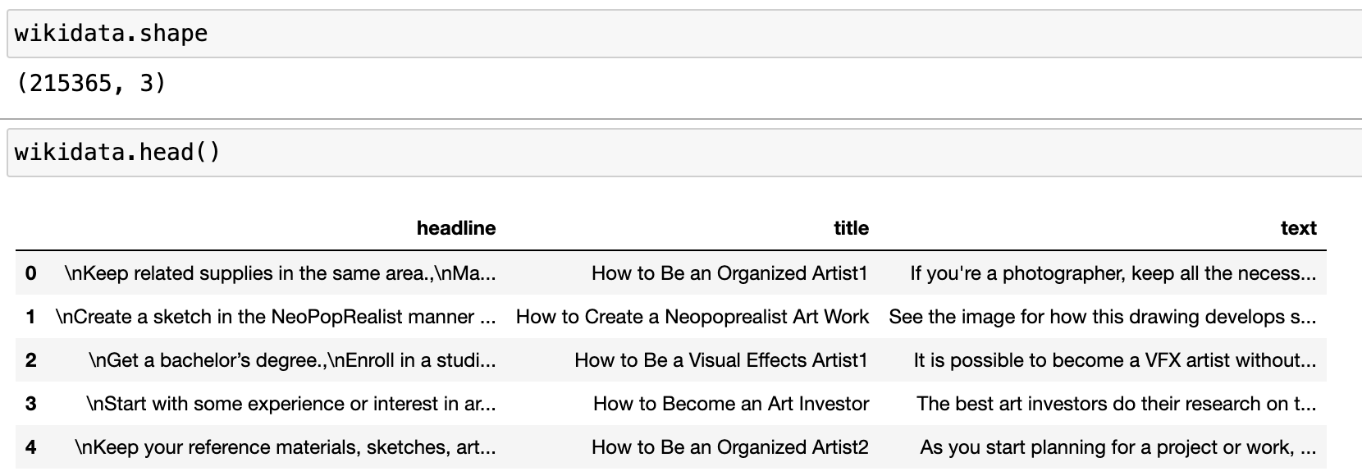
Dataset Description
Obtained WikiHow dataset from Hugging Face
Used only ~10% of the dataset due to memory and computation limits
Each input column is an article from WikiHow on How to ...?
Each output column is the concatenation of all the headlines in each article
Training Data | Validation Data | Test Data
20000 | 5599 | 5577
Notes:
Vishal

Slide 4
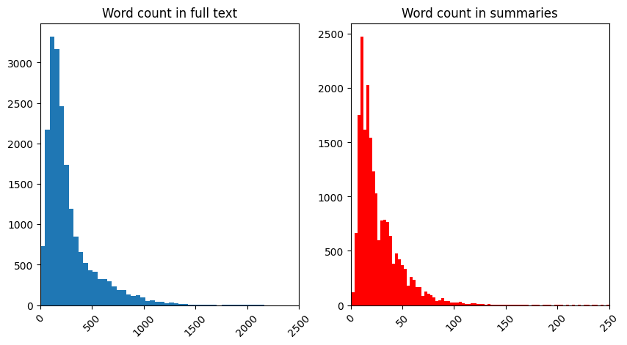
Data Preprocessing
Converted texts into tokens using respective LLM tokenizers for each LLM.
Used BART based tokenizers for models built on BART
Used T5 based tokenizers for models built on T5
Truncation and padding was done to maintain consistent token length
Max output token lengths for baseline models was calculated based on the plots below.
Notes:
Prashanth

Slide 5
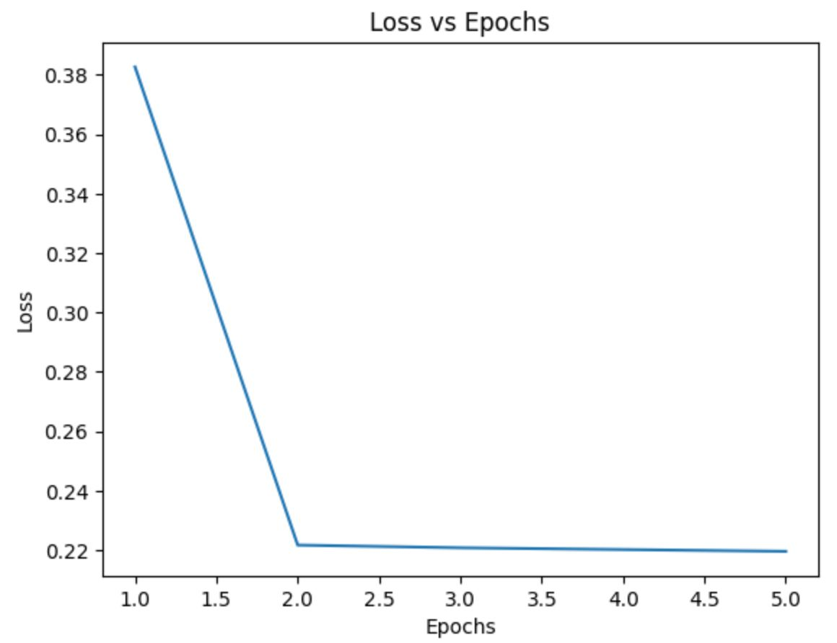
Baseline Model - LSTM
Designed functions to preprocess the data such as tokenization, removal of stop words and padding to ensure articles and summaries have uniform length
Built a sequential model using Keras, with an embedding layer and an LSTM layer for each encoder and decoder, and a repeat vector layer between them
The model has a final time distributed dense layer for generating output sequences.
Training was done to optimize sparse categorical cross entropy loss
Actual Summary: 'Create a dry mix for your hamster.\nMake healthy treats.\nUnderstand the drawbacks of homemade food.'
Predicted summary:
‘consider the the the the the the the the the the the the the’
Notes:
Rohit

Slide 6
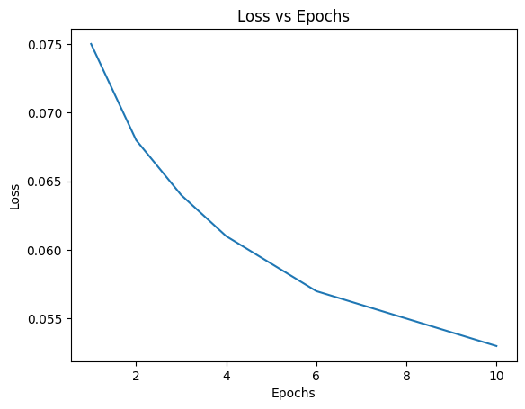
Baseline Model - Seq2Seq Transformer
Designed functions to preprocess the data such as tokenization, removal of stop words and padding to ensure articles and summaries have a predetermined max token length
Positional encoding is added to the input to retain context
Two layers each are used in the encoder and decoder blocks with four multiple attention heads.
Layer normalization and residual connections are applied within each sub-layer
Masked softmax cross entropy loss is used as loss function
Actual Summary: 'Create a dry mix for your hamster.\nMake healthy treats.\nUnderstand the drawbacks of homemade food.'
Predicted summary:
'give hamster cage'
Notes:
Vishal

Slide 7
Bart-base & T5-small LLMs
Loaded pre-trained sequence-to-sequence LLMs from Hugging Face
Performed predictions directly on the pre-trained models before any fine-tuning/transfer learning.
Compared the performance of T5 model with and without prompt embedded into the input (“Summarize: …….”)
Actual Summary: 'Create a dry mix for your hamster.\nMake healthy treats.\nUnderstand the drawbacks of homemade food.'
Predicted summary:(BART-base)
'Hamsters should eat a dry mix of food made from a variety of fruits, vegetables'
Predicted Summary:(T5-small) ',, and a variety of fresh fruits and vegetables. Mix dried foods together to'
Predicted Summary:(T5-small with prompt) 'hamsters need carbohydrates, proteins, and fats to function properly. ham'
Notes:
Prashanth

Slide 8
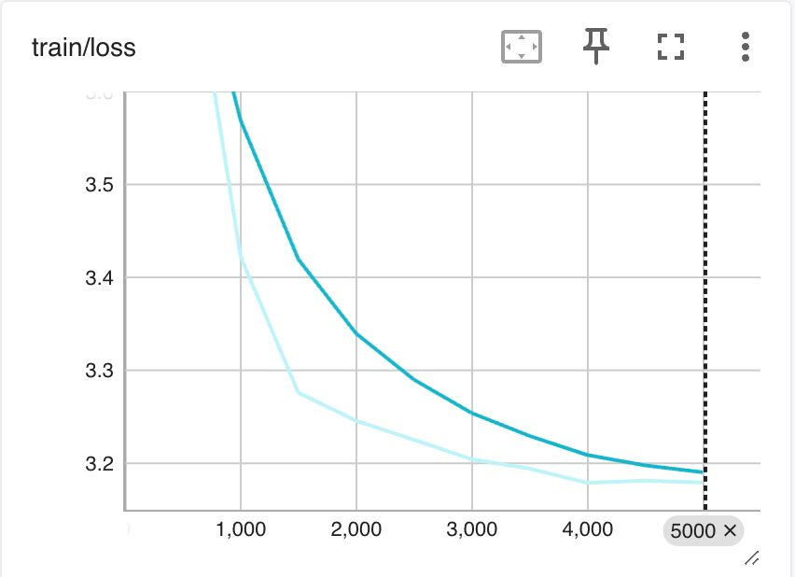
Fine-Tuning T5-small using Simple Fine-Tuning
Fine-tuning the entire LLM definitely gives better results, but is computationally challenging.
Fine-tuned the model by just unfreezing the last two layers of the encoder and updated the weights and biases of those layers before training.
Actual Summary: 'Create a dry mix for your hamster.\nMake healthy treats.\nUnderstand the drawbacks of homemade food.'
Predicted summary:
"hamsters, like, humans need carbohydrates, proteins, and fats to function properly . a combination of nuts, seeds, and low starch vegetables are important for the body's health . add ingredients in processed food made for humans ."
Notes:
Prashanth

Slide 9
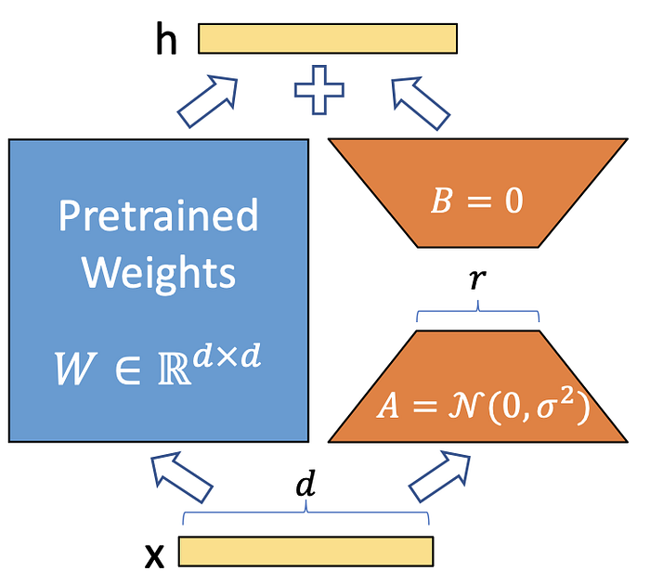
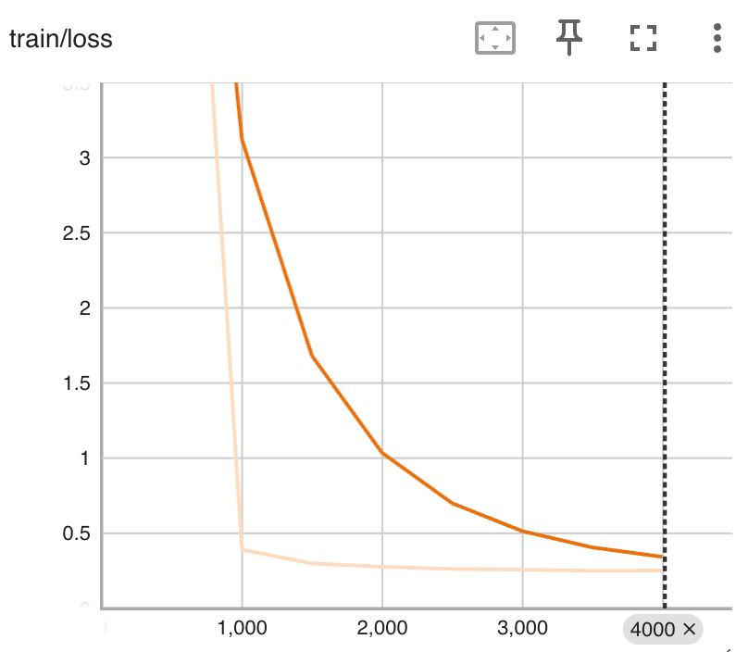
Fine-Tuning T5-small using LoRA
PEFT is an approach to fine-tune only a small number of (extra) model parameters while freezing most parameters of the pretrained LLMs
LoRA (Low Rank Adaptation), is a PEFT technique designed for fine-tuning pretrained models in a more computational and memory efficient manner
Actual Summary: 'Create a dry mix for your hamster.\nMake healthy treats.\nUnderstand the drawbacks of homemade food.'
Predicted summary:
"a combination of nuts, seeds, and low starch vegetables are important for a hamster's physical wellbeing . you can find dried varieties of these foods at a local grocery store and mix them together ."
Notes:
Rohit

Slide 10
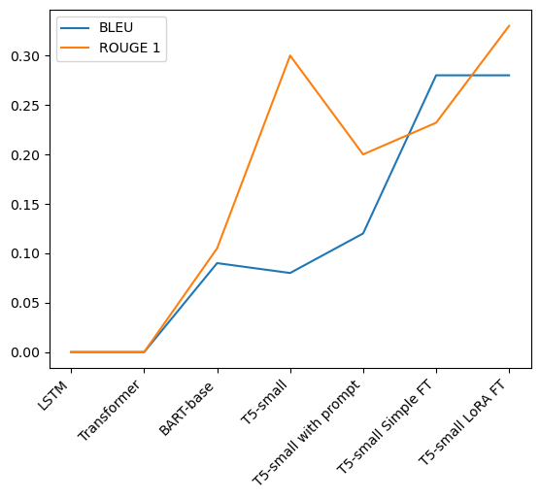
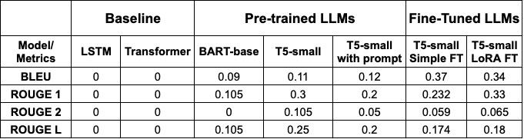
Model Performance & Evaluation
Notes:
Rohit

Slide 11
LLMs Models Used
Pre-Trained Models
BART Base : https://huggingface.co/facebook/bart-base
T5 Small : https://huggingface.co/t5-small
Fine-Tined Models
T5 SFT : https://huggingface.co/Prashanth-1998/wikihow_t5small_model
T5 LoRA : https://huggingface.co/rohitmacherla3/wikihow_t5small_LoRA_fine_tuned

